Slide 1
RPG

Slide 2

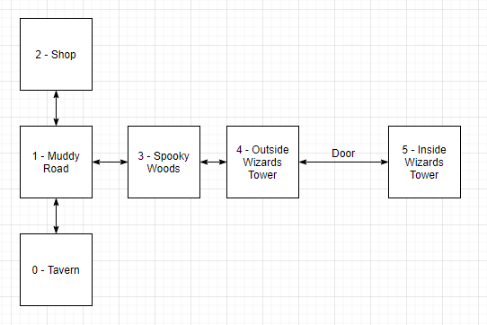

Slide 3
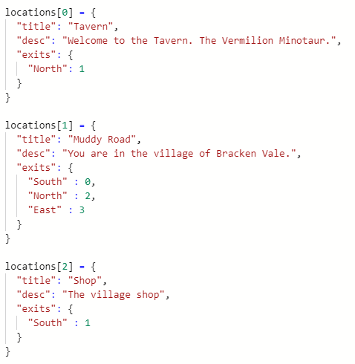
https://repl.it/@JohnGlazebrook/rpg-game-v1-dictionary-t-level-2020

Slide 4
Demo code
https://replit.com/@JohnGlazebrook/rpg-pick-up-item
https://replit.com/@JohnGlazebrook/rpg-game-v1-dictionary-t-level-2020
https://replit.com/@JohnGlazebrook/rpg-game-v2-dictionary-t-level-2020
https://replit.com/@JohnGlazebrook/t-level-rpg-combat-1

Slide 5
https://henrikwarne.com/2012/06/02/why-i-love-coding/

